Slide 1
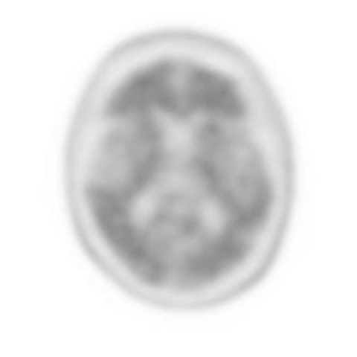
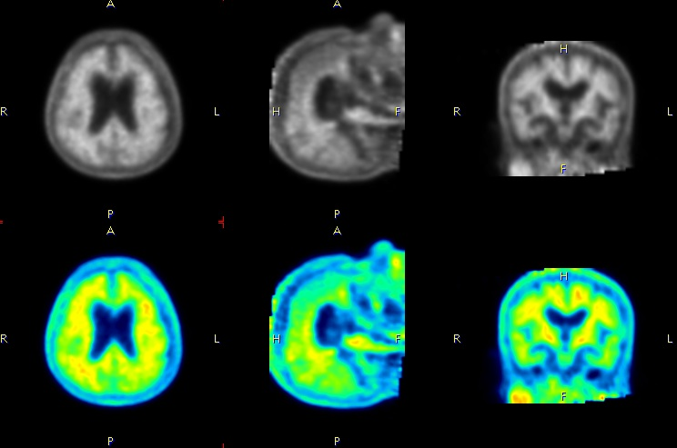
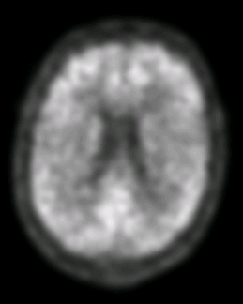
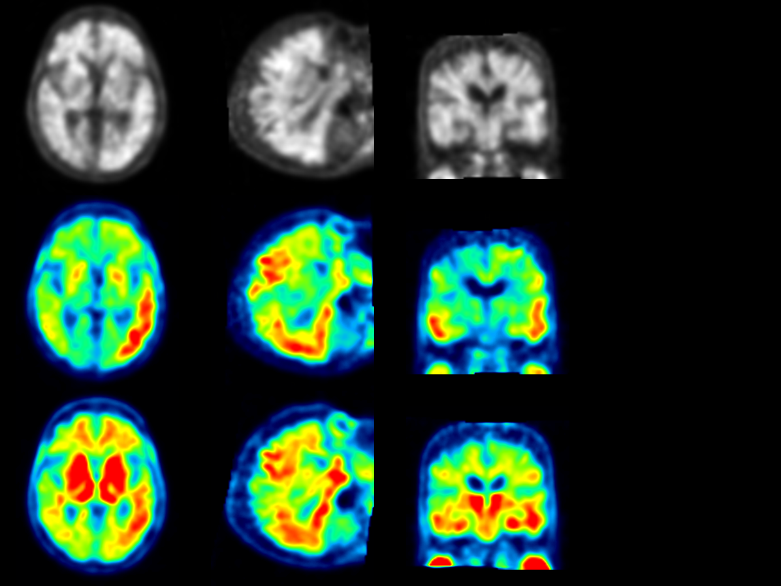
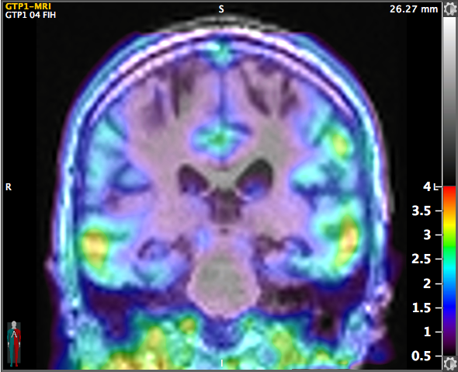




18F-Florbetaben PET Amyloid Imaging in the Clinical Management of Memory Impairment: Where are we now, How did we get here, and where are we going?
John P. Seibyl, MD
Institute for Neurodegenerative Disorders, MNI/invicro, LLC, and
Yale University School of Medicine,
New Haven, USA

Slide 2
Disclosure
Equity interest inviCRO, LLC
Consultant- GE Healthcare, Roche, Piramal Imaging

Slide 3
Goals
To develop an appreciation of the roles of β-amyloid in the pathophysiology and diagnosis of Alzheimer’s
Understand the appropriate uses of amyloid PET imaging as aid to dementia evaluation
Develop a systematic approach to visual interpretation of PET amyloid images
Understand new research directions and clinical trials which may influence the role of imaging in clinical practice

Slide 4
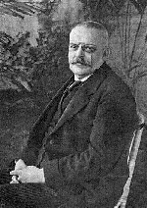
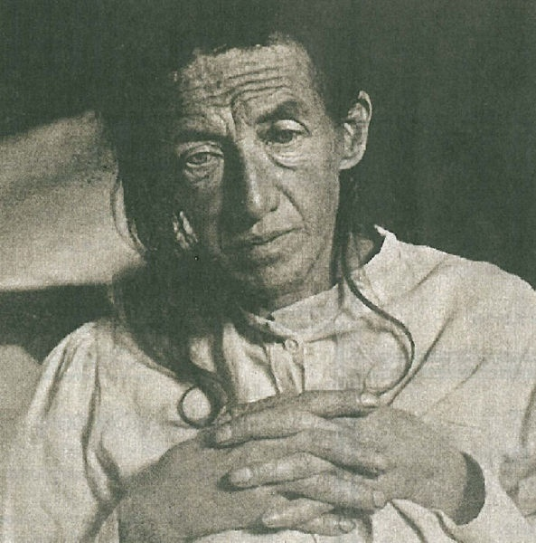
Dr. Alois Alzheimer (1864 – 1915)
1911: described pathologic changes including plaques and neurofibrillary tangles in a case study of a woman with cognitive changes
Notes:
Dr. Alzheimer started his medical career in a histological Laboratory and eventually spent 5 years working in a municipal mental institution in Frankfurt Germany. His experience there had a profound effect on his future studies.
The importance of his early background lies in the fact that while working in Frankfurt, Dr. Alzheimer was able to contribute to the development of a modern clinical service and at the same time set up a scientific patient database and autopsy case archive that he would utilize in his later research.
His studies involving atherosclerosis of the brain led him to investigate other senile processes and of course, dementia. By 1911, Dr. Alzheimer published an article discussing the various aspects of the disease that would bear his name. He had noted the pathology of the cerebral cortex involving the first description of neurofibrillary tangles of Alzheimer’s disease.

Slide 5
Alzheimer’s Disease Symptoms
Impaired memory and thinking
Disorientation and confusion
Difficulty with abstract concepts
Behavior and/or personality changes
Loss of judgment
Impaired communication and language
Loss of motivation or initiative
Changes in sleep patterns
Notes:
This list of symptoms although commonly associated with Alzheimer’s can also be associated with other medical conditions such as: depression, the effects of certain medications, chemical imbalances within the body, poor nutrition, or neurological tumors.
These symptoms also can be a result of other types of dementia such as frontal lobe or vascular dementia
For that reason, testing must be capable of ruling out curable causes as at this time there is no cure for Alzheimer’s disease.

Slide 6
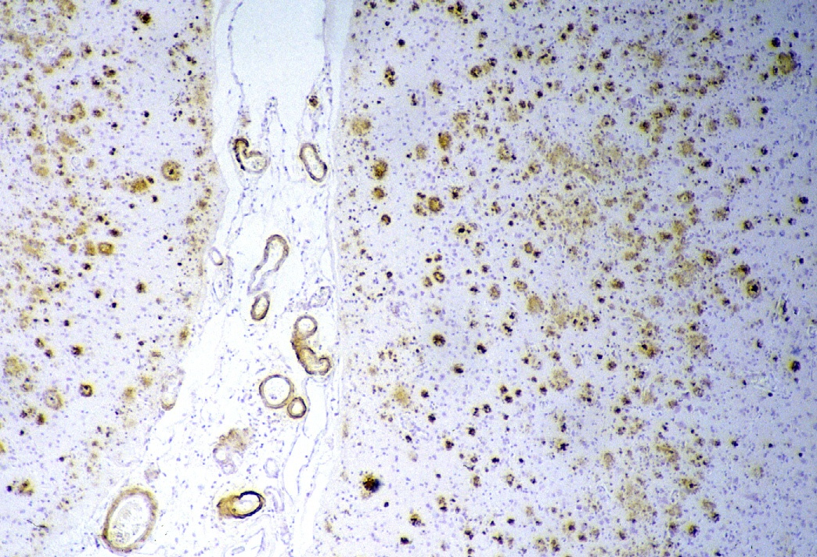
6
Notes:
6

Slide 7
ALZHEIMER’S PATHOGENESIS
Neuronal toxicity due to a-beta
Notes:
The pathophysiology of Alzheimer’s has been clarified in the last few years. Most scientists now agree that Alzheimer’s is due to the accumulation of a polypeptide (Amyloid beta) of 42 amynoacids derived from abnormal degradation of a physiologically present protein (amyloid precursor protein – APP). Small aggregates of Abeta42 (oligomers) accumulate in the brain for decades into extracellular plaques causing synaptic loss and neuronal death. The brain’s functional reserve is slowly eroded until the first memory symptom finally develop.

Slide 8
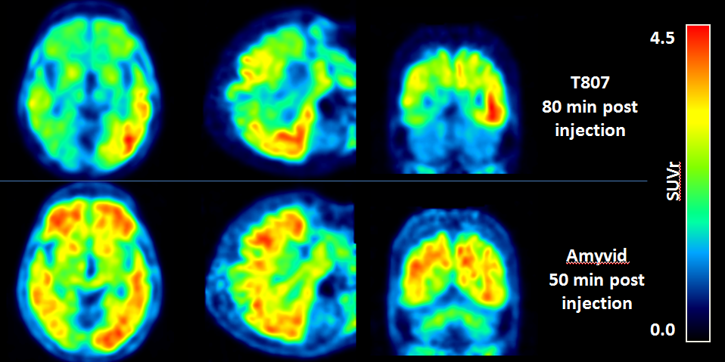
PET Imaging of Tangles and Plaques
Tau
Amyloid

Slide 9
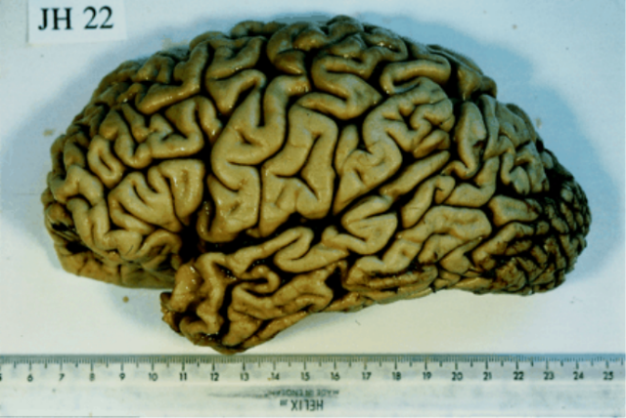
Diagnosing Alzheimer’s Disease
Brain, Vol. 123, No. 3, 484-498, March 2000
Notes:
In spite of the fact that it is so common, Alzheimer's disease often goes unrecognized because the symptoms at times appear gradually and may be viewed as normal decline associated with the inevitable consequences of aging.
A definite diagnosis can at this time only be made post mortem, so we are actually talking about diagnosing “probable” A.D.
Alzheimer's disease can only be diagnosed post mortem, when the brain can be closely examined for the microscopic changes caused by the disease.
However, through thorough testing and a "process of elimination," doctors today can diagnose what they refer to as probable Alzheimer's disease with almost 90% accuracy.
Dementia with Lewy bodies, the second most frequent cause of degenerative dementia in elderly adults, is a neurodegenerative disorder associated with abnormal structures (Lewy bodies) found in certain areas of the brain. Because these structures and many of the symptoms of dementia with Lewy bodies are associated with Parkinson's and Alzheimer's diseases, researchers do not yet understand whether dementia with Lewy bodies is a distinct clinical entity or perhaps a variant of Alzheimer's or Parkinson's disease. Recent research has revealed that Lewy bodies contain deposits of a protein called alpha-synuclein that is also linked to Parkinson's disease and multiple system atrophy. Symptoms can range from traditional parkinsonian effects, such as loss of spontaneous movement (bradykinesia), rigidity (muscles feel stiff and resist movement), tremor, and shuffling gait, to effects similar to those of Alzheimer's disease, such as acute confusion, loss of memory, and loss of, or fluctuating, cognition. Visual hallucinations may be one of the first symptoms noted, and patients may suffer from other psychiatric disturbances such as delusions and depression. Onset of the disorder usually occurs in older adults, although younger people can be affected as well. In 1996 scientists published guidelines for the diagnosis of dementia with Lewy bodies (McKeith IG, et al, Neurology, vol 47, pp 1113-1114, Nov 1996).
Image:
Macroscopic pathological appearance of case 6 (P.B.) showing the severe left temporal atrophy.
Pathological examination revealed severe atrophy of the left temporal lobe and mild generalized cerebral atrophy (Fig. 3 ). Microscopically, there was extensive Alzheimer-type pathology throughout the cerebral cortex, particularly in the temporal association cortex and perisylvian cortex. There was marked cell loss in the temporal cortex and no evidence of Pick's pathology. The lesions were typical of Alzheimer's disease but the distribution was very atypical. There were a few isolated Lewy bodies in the cortex with insignificant brainstem involvement. The pathological diagnosis was Alzheimer's disease
This case illustrates a mixed aphasic presentation with initial problems in both semantic aspects of language (naming and word comprehension) and syntactic features (impairments both in expressive and receptive grammar), plus some phonological errors in spontaneous speech. Neuropathologically, there was a highly atypical distribution of Alzheimer's disease-type pathology, principally involving the temporal poles

Slide 10
Cognitive Decline is Non-Specific
Mild Cognitive Impairment (MCI)
Multi-Infarct or Vascular
Frontotemporal Dementia (Pick’s)
Dementia with Lewy Bodies
Parkinson’s Disease dementia
Pseudo-dementia of depression
Metabolic/endocrine disease
Normal aging
Notes:
There are several other types of dementia’s that often mimic A.D symptoms.
Physicians have a difficult task in distinguishing these disease states from Alzheimer’s disease, which is the most common cause of dementia in older persons. It is possible for a person to have both multi-infarct dementia and Alzheimer’s disease, complicating the diagnosis further.
http://www.ninds.nih.gov/disorders/dementiawithlewybodies/dementiawithlewybodies.htm

Slide 11
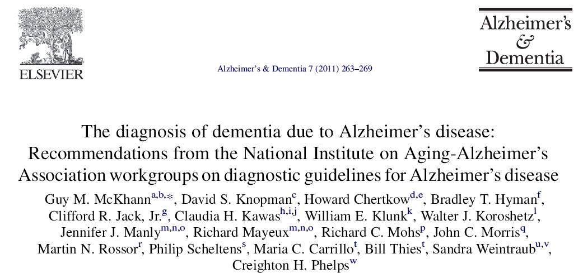
Revises NINCDS-ADRDA criteria (1984) with consideration now of
biomarker information in the diagnosis of probable and possible AD

Slide 12
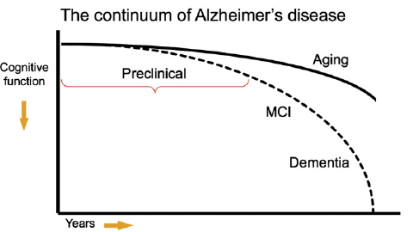
New NIA-AA Diagnostic Approaches

Slide 13
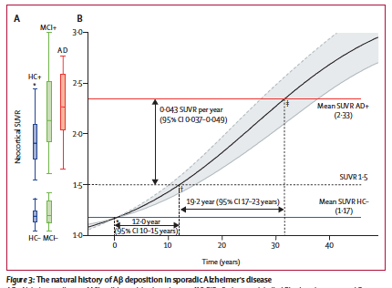
Natural History of Amyloid Burden
Villemagne, V. L., S. Burnham, et al. (2013). "Amyloid beta deposition, neurodegeneration, and cognitive decline in sporadic Alzheimer's disease: a prospective cohort study." Lancet neurology 12(4): 357-367.

Slide 14
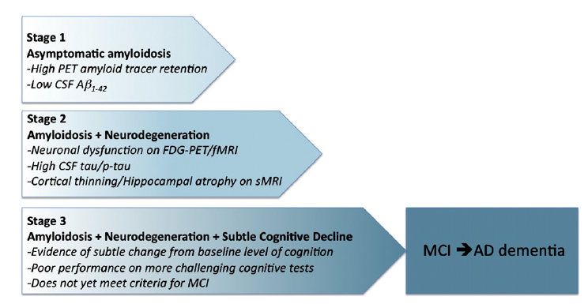
A Model for Preclinical AD

Slide 15
NIA-AA Criteria for AD Dementia
NIA-AA Criteria | Characteristics
Definite AD Dementia | Pathologically Proven with Typical Clinical Course
Probable AD Dementia | - May be Biomarker Enhanced
Possible AD Dementia | Atypical Presentation Comorbidities May be Biomarker Enhanced
Not AD | Negative Biomarkers

Slide 16
SUVR amyloid PET concordance with CSF biomarkers
BioFINDER
ADNI
2.0
2.0
SUVR
1.6
1.6
SUVR
1.2
1.2
PET visual
Positive
0.8
0.8
Negative
Cut-off
1000
2000
3000
1000
2000
3000
Abeta42 pg/mL
Abeta42 pg/mL

Slide 17
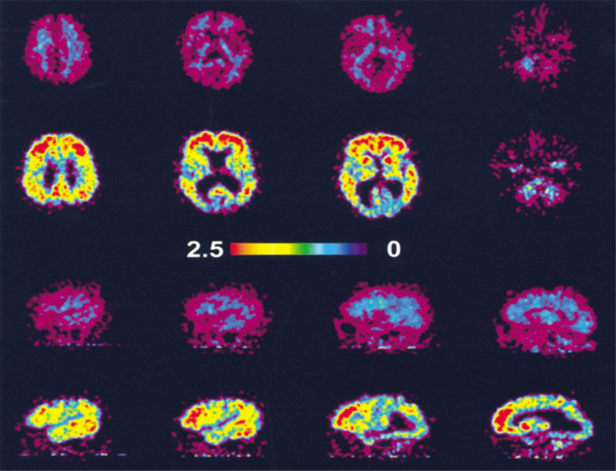
11C- PIB Amyloid Imaging
HC
AD
HC
AD
Klunk et al. Annals of Neurology; 2004:306-319
Notes:
Amyloid imaging; indicates accumulation of plaques in AD brain versus healthy controls with significant differences in qualitative analysis.

Slide 18
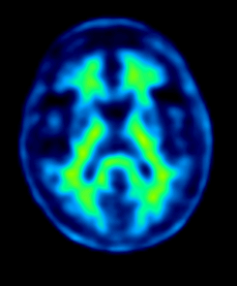
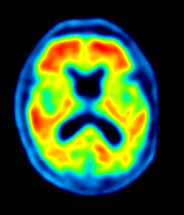
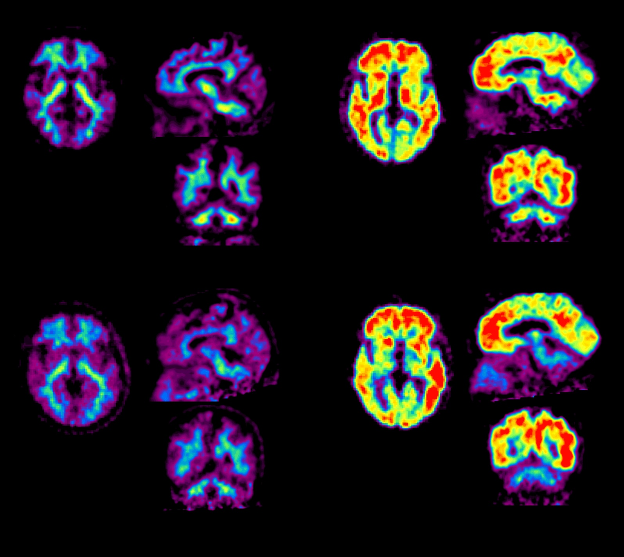
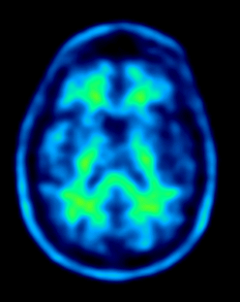
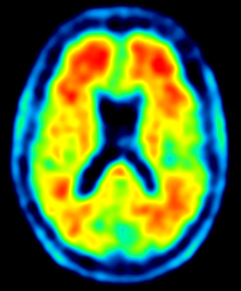
Healthy
volunteers
Alzheimer’s
patients
¹⁸F-Florbetaben
¹⁸F-Flutemetamol
¹⁸F-Florbetapir
Notes:
18

Slide 19
Radiotracer Comparison
 | Florbetapir | Flutemetamol | Florbetaben
Injected dose | 370 MBq | 185 MBq | 300 MBq
Imaging protocol | 2 x 5 min frames 50 m pi | 4 x 5 min frames 90 m pi | 3 x 5 min frames 90 m pi
Reading scale | Grey only | Rainbow | Grey only
Views | 3 orthogonal | 3 orthogonal | Axial primarily
Regions for + scan | 2 regions | 1 region | 1 region

Slide 20
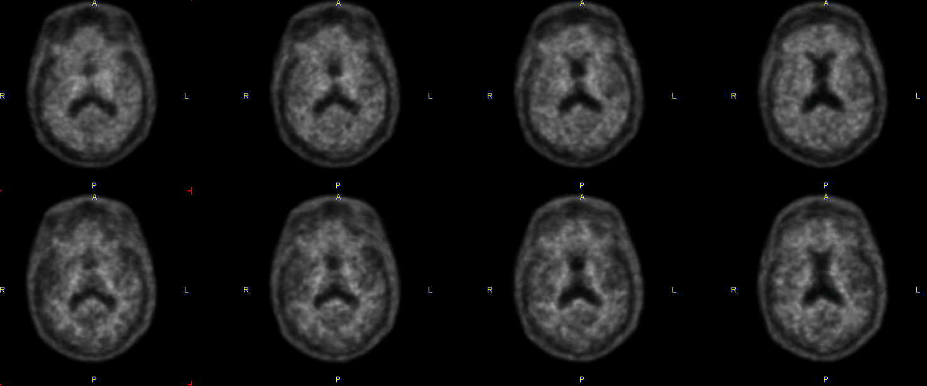
NAV4694 in AD and Healthy Volunteer

Slide 21
18F PET Amyloid imaging
Tracers demonstrate approx 1.5 - 2 fold increase in amyloid binding in precuneus, cingulate, frontal, temporal, parietal cortex
No safety problems
Amyloid imaging correlated with pathology
Amyloid positive amnestic MCI at high risk of conversion to AD
Likely progression of amyloid uptake in MCI and AD subjects

Slide 22
.
Florbetapir – Imaging-Pathology correlation
Reproduced from Clark, et al. JAMA, 2011

Slide 23
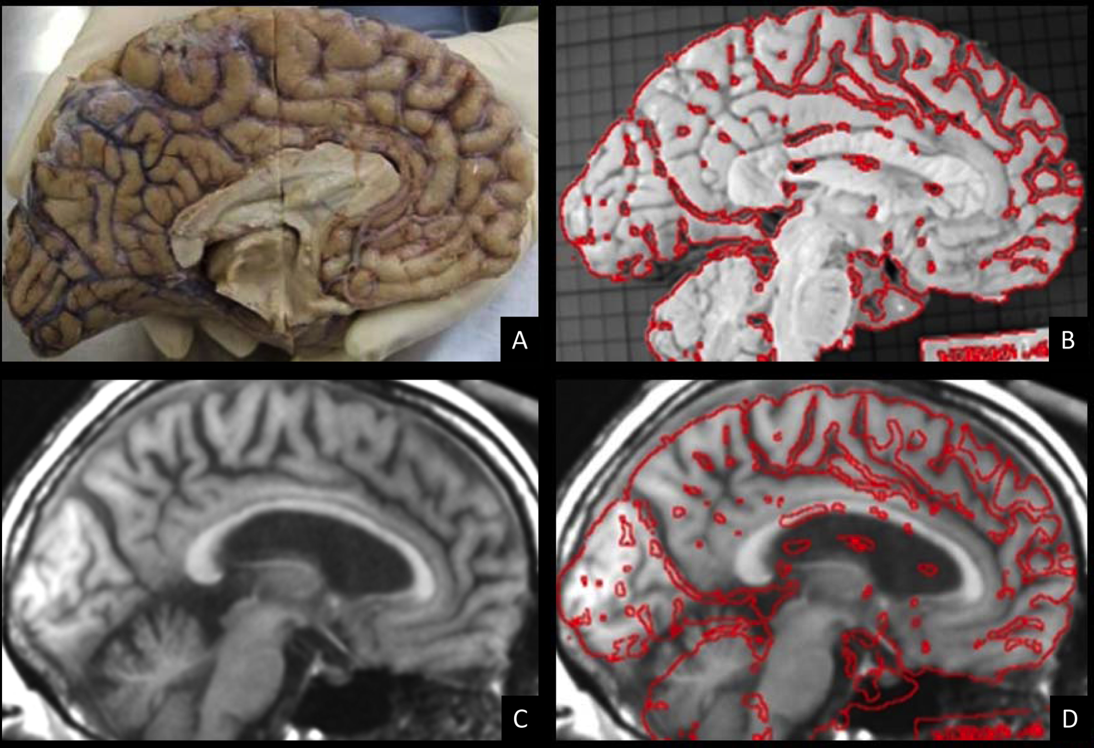

Slide 24
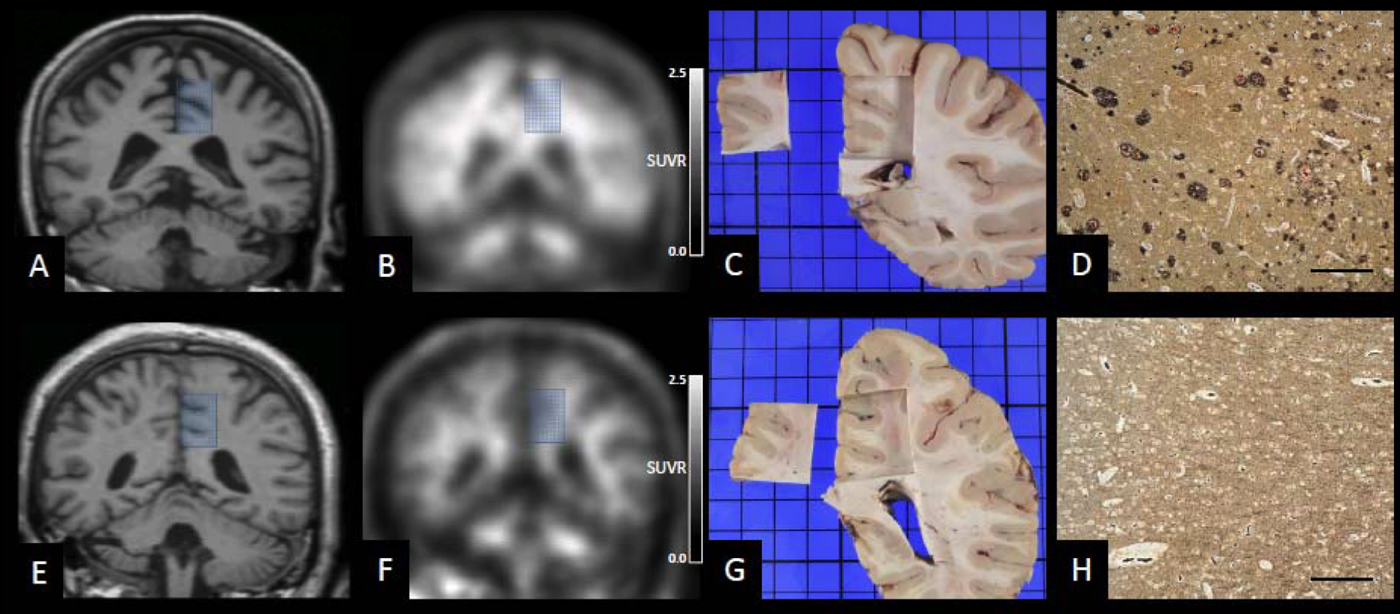

Slide 25
Results
Primary efficacy variables: Regional PET assessment compared to regional consensus histopathology, based on majority read
Results for each brain region
Region | Sensitivity | Specificity
Middle frontal gyrus | 85.7% | 95.0%
Occipital cortex | 88.9% | 86.4%
Hippocampus | 57.1% | 100.0%
Anterior cingulate cortex | 90.0% | 85.7%
Posterior cingulate cortex | 81.0% | 94.4%
Cerebellar cortex | 0.0% | 100.0%
Notes:
4 positive Cases im Cerebellar cortex: 2 in silver staining, 2 in IHC, „Diffuse beta-amyloid in most cases“ → End stage diseases

Slide 26
Comparative Sensitivity and Specificity of Visual Reads vs Histopathology
Sponsor | Tracer | Number of Brains | Sensitivity | Specificity
Avid | Florbetapir | 35 | 93 | 100
Piramal | Florbetaben | 31 | 100 | 92
GEHC | Flutemetamol | 68 | 86 | 92

Slide 27
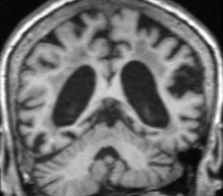
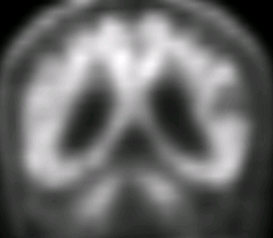
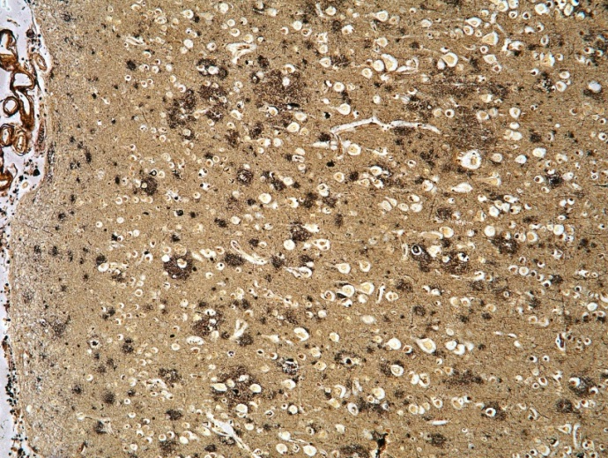
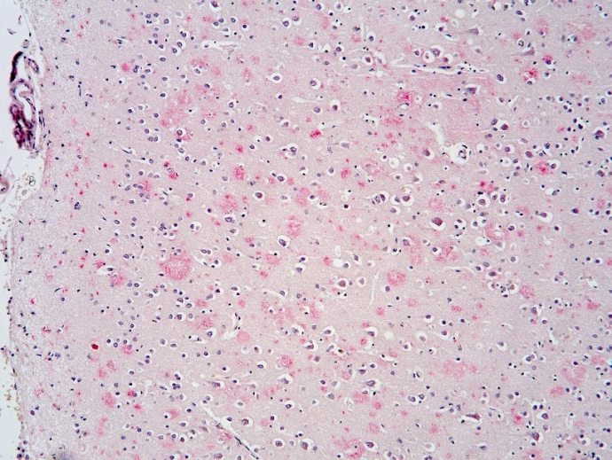
Results
Florbetaben detects diffuse Aβ plaques
In vivo florbetaben PET
In vivo MRI
Post mortem Bielschowsky silver staining for β-amyloid plaques
Post mortem immunohisto-chemistry for β-amyloid plaques

Slide 28

Visual Assessment - ¹⁸F – Florbetaben
Visual Assessment of the images follows a simple 3 step algorithm.
      1. Assess technical adequacy
      Review individual regions as positive or negative;
        Lateral Temporal Lobes
        Frontal Cortex
        Posterior Cingulate/Precuneus
        Parietal Cortex
      3. Provide overall assessment of Images;
        Negative
        Positive

Slide 29
Technical Adequacy - ¹⁸F – Florbetaben
Assess the technical quality
  Is there significant motion artifact resulting in blurring of contrast between GM and WM structures?
  Has the attenuation map been applied appropriately or has there been movement between the time that the transmission/CT scan and emission scan was acquired?
  Is the head properly oriented?
  Are the images too smooth?
  To avoid over saturation the thresholding window should be properly set.

Slide 30
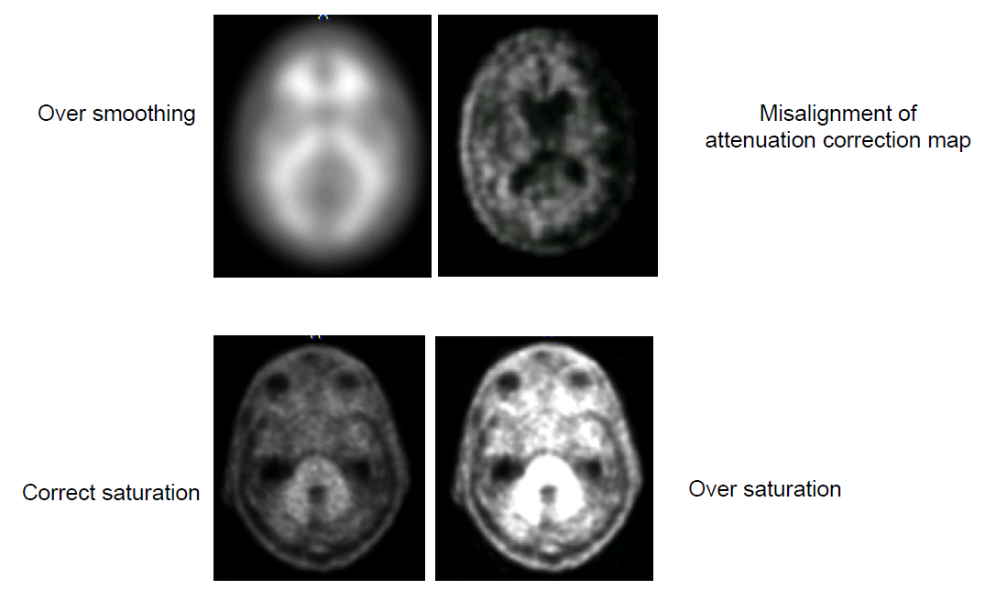
Common Artifacts - ¹⁸F – Florbetaben
Examples of inadequate image quality

Slide 31
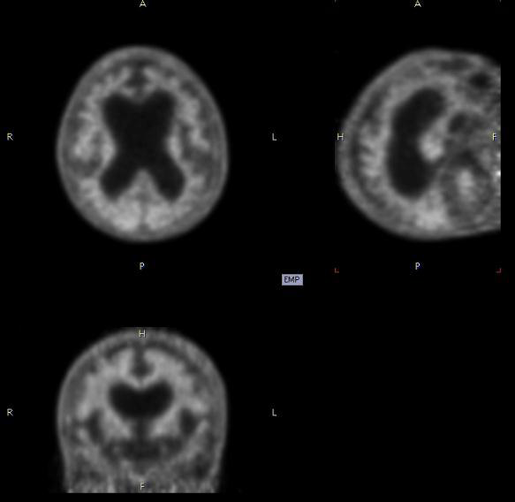
Atrophy - ¹⁸F – Florbetaben
Example of Atrophy

Slide 32
Visual Assessment- ¹⁸F – Florbetaben
2. Review individual regions as positive or negative
Visual assessment should be performed systematically starting at the inferior margin of the brain moving superiorly using the cerebellum as reference.
      Lateral Temporal Lobes
      Frontal Cortex
      Posterior Cingulate/Precuneus
      Parietal Cortex

Slide 33
Understanding White/Gray Anatomy is Key
to Visual Interpretation of 18F-FBB PET

Slide 34
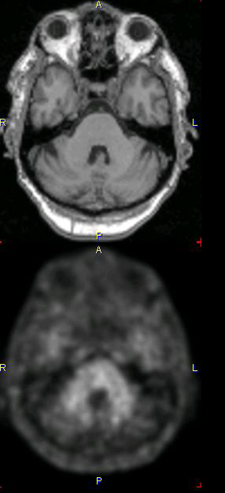
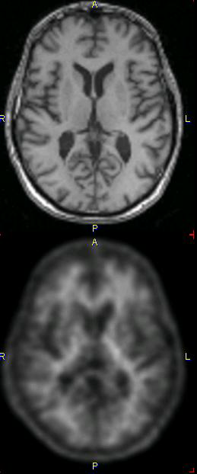
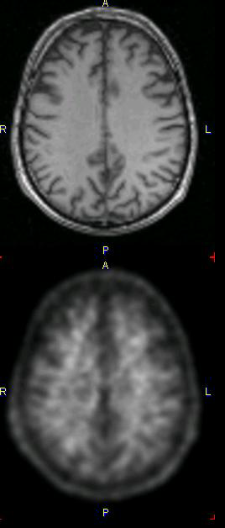
Negative Scan ¹⁸F – Florbetaben
During the visual assessment focus on the white and gray matter anatomy.
Tracer uptake by white matter alone means the scan is negative!

Slide 35
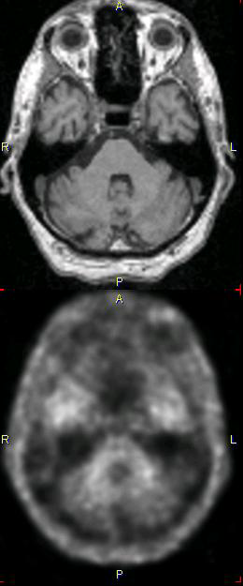
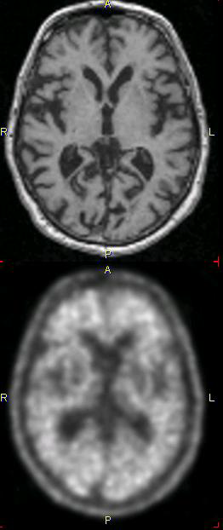
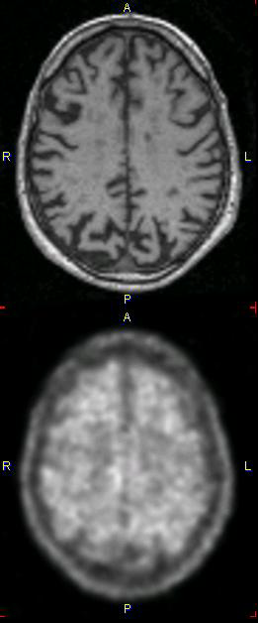
Positive Scan ¹⁸F – Florbetaben
During the visual assessment focus on the white and gray matter anatomy.
Tracer uptake by both white and gray matter in the specified regions means the scan is positive!

Slide 36
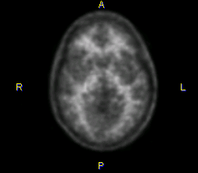
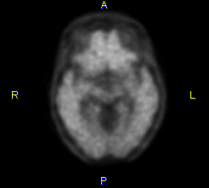
Lateral Temporal Lobes - ¹⁸F – Florbetaben
Typical pattern of radiotracer uptake in the Lateral Temporal Lobes.
In negative scans the white matter shows mountainous appearance, with spikes on the outer edge.
In positive scans there is no mountainous appearance of the white matter and activity extends to the outer edge of the cortex. There is no difference between gray and white matter throughout the region.

Slide 37
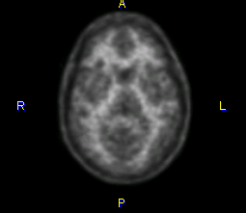
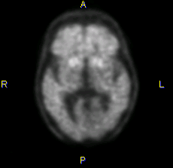
Frontal Lobes - ¹⁸F – Florbetaben
Typical pattern of radiotracer uptake in the Frontal Lobes.
In negative scans the white matter has a “spiky” appearance with concave borders. Activity seems to extend to the end but it doesn’t.
In positive scans there is no difference between gray and white matter throughout the region. The white matter has no “spiky” pattern, but rather a smooth, convex appearance of the external cortical edges.

Slide 38
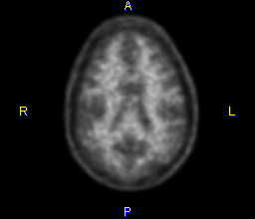
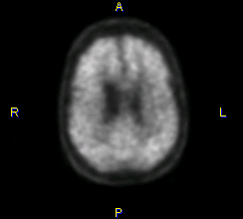
Posterior Cingulate & Precuneus- ¹⁸F – Florbetaben
Typical pattern of radiotracer uptake in the Posterior Cingulate/Precuneus.
In negative scans there is a hypo-intense hole or “doughnut hole” in the posterior cingulate.
In positive scans there is no hypo-intense hole or the “doughnut hole” is filled in.

Slide 39
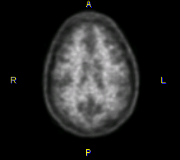
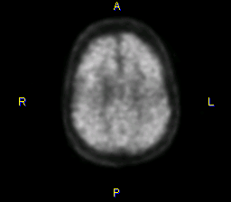
Parietal Lobes - ¹⁸F – Florbetaben
Typical pattern of radiotracer uptake in the Parietal Lobes.
In negative scans the interhemispheric line is well-delineated with irregular “ratty” external border appearance.
In positive scans the interhemispheric division is barely discernible and the appearance of the midline is smooth. There is no difference between gray and white matter throughout the region.

Slide 40
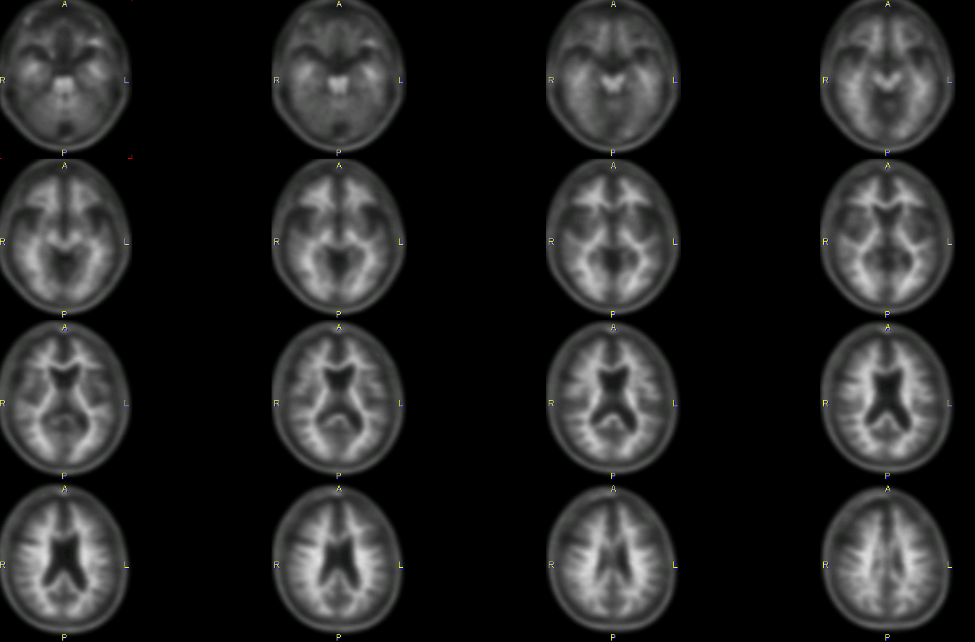

Slide 41
Recap - ¹⁸F – Florbetaben
Negative Pattern
Lateral Temporal – Mountains
Frontal Lobes – Spikes, Concavities
Posterior Cingulate & Precuneus- Doughnut Hole
Parietal Lobes – Clear Midline, Ratty Borders
Remember, take in account the majority of the slices
within a given region when making your assessment!

Slide 42
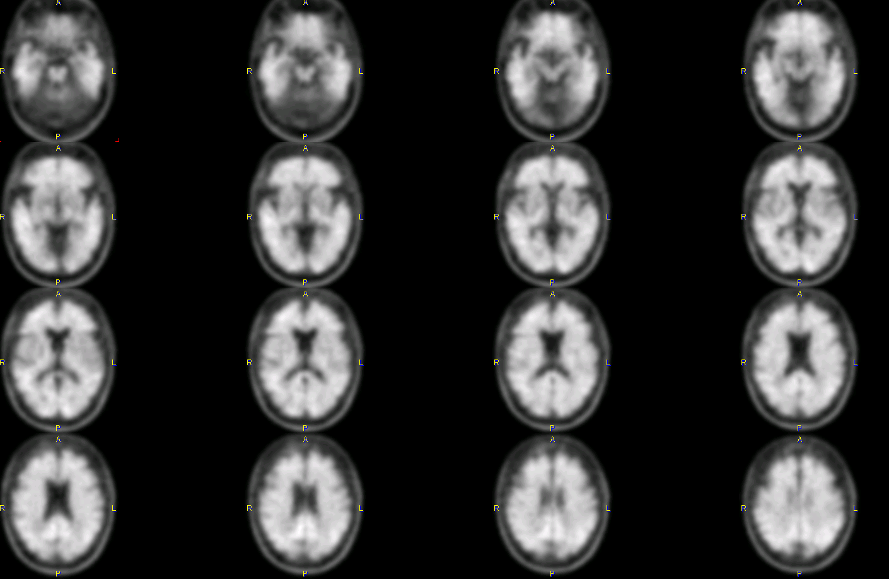

Slide 43
Recap- ¹⁸F – Florbetaben
Positive Pattern
Lateral Temporal – NO Mountains
Frontal Lobes – NO Spikes or Concavities
Posterior Cingulate & Precuneus - Doughnut Hole Filled In
Parietal Lobes – Indiscernible Midline, Smooth Borders
Remember, take in account the majority of the slices
within a given region when making your assessment!

Slide 44
Recap- ¹⁸F – Florbetaben
Remember
One single Positive region makes the whole scan Positive
In the great majority of scans read as Positive, all regions are Positive

Slide 45
Common Questions about Aβ PET Imaging: Clinical Research to Clinical Practice
Which patients are best evaluated with the test? Will there be reimbursement?
What is the role of Aβ PET in selecting patients for treatment?
What is the place of image quantitation?
Should imaging be used for longitudinal monitoring of patients?

Slide 46
In Clinical Practice…
Major goal is to identify whether a patient
has dementia
or
Major goal is to determine the cause of a patient’s cognitive deficits
Courtesy Dr. Norm Foster.

Slide 47
In Clinical Practice (cont.)…
A clinician treats all patients with neurodegenerative dementia the same way, irrespective of the cause of dementia
or
A clinician treats patients with neurodegenerative dementia differently, depending upon the cause
Courtesy Dr. Norm Foster.

Slide 48
Preamble to Appropriate Use Criteria
“…when knowledge of the presence or absence of Aβ pathology is expected to increase diagnostic certainty
and alter management.”
Therefore, if answer A to either question is true, there is no reason to order amyloid PET imaging
  Amyloid imaging cannot determine whether a patient
  has dementia
  Does cause of dementia really not matter?
Courtesy Dr. Norm Foster.

Slide 49
Appropriate Use of Amyloid PET
Patients with persistent or progressive
unexplained MCI
Patients satisfying core clinical criteria for possible AD because of unclear clinical presentation, either an atypical clinical course or an etiologically mixed presentation
Patients with progressive dementia and atypically early age of onset (usually defined as 65 years or younger in age)
Johnson KA, et al. Alzheimers Dement. 2013;9(1):e-1-16.

Slide 50
Inappropriate Use of Amyloid PET
Patients with core clinical criteria for probable AD with typical age of onset
To determine dementia severity
Based solely on a positive family history of dementia or presence of apolipoprotein E (ApoE) ɛ4
Patients with a cognitive complaint that is unconfirmed on
clinical examination
In lieu of genotyping for suspected autosomal mutation carriers
In asymptomatic individuals
Nonmedical use (eg, legal, insurance coverage, or
employment screening)
Johnson KA, et al. Alzheimers Dement. 2013;9(1):e-1-16.

Slide 51
PET Biomarkers in AD Clinical Trials
Enrollment criteria, subject pool enrichment, screening for
soon-to-be-approved expensive therapies
Disease monitoring and evaluation of drugs to slow
progression or modify pathophysiology
Identifying at-risk populations
Will these Provide a Model for Clinical Practice?

Slide 52
Rates of Negative Amyloid PET in Different AD Clinical Trials
Study | Screening Scans | Number positive scans | % positive | % negative
A | 1301 | 391 | 30 | 70
B | 127 | 84 | 66 | 34
C | 154 | 119 | 77 | 23
D | 1023 | 593 | 58 | 42
E | 124 | 108 | 87 | 13
F | 2628 | 1918 | 73 | 27

Slide 53
Rates of Negative Amyloid PET in Different AD Clinical Trials
Study | Population Diagnosis | Screening Scans | Number positive scans | % positive | % negative
A | Preclinical AD | 1301 | 391 | 30 | 70
B | Early AD | 127 | 84 | 66 | 34
C | Early AD | 154 | 119 | 77 | 23
D | Early AD | 1023 | 593 | 58 | 42
E | Mild AD | 124 | 108 | 87 | 13
F | Mild AD | 2628 | 1918 | 73 | 27

Slide 54
Factors Influencing Rates of Negative Scans in AD Multicenter Therapeutic Trials
Recruitment Population- prodromal, mild,
or moderate AD
APoE4 status
Screening Strategy- Role of PET as gatekeeper or
final confirmation after extensive prior screening
Site Specific Issues- Local clinical diagnostic standards
differ despite attempts to operationalize

Slide 55
Special Issues of Amyloid PET in Identifying
At-Risk Patients
Are visual read algorithms properly tuned to identifying “at risk levels” of amyloid pathology on scans?
What are the reader biases in interpreting scans knowing the patient is cognitively normal?
Should quantitation, adequately vetted, be the sole method for determining eligibility?

Slide 56
Visual vs quantitative reads for eligibility
Visual reads by the core PET labs have quicker turn-around, as more steps involved in quantitation
Visual amyloid interpretation algorithms have changed as 18F amyloid tracers are themselves in active clinical development
Quantitative assessments (e.g. composite SUVr) are more“objective”
Need to pick a SUVr eligibility cut-off, pick a point on the ROC curve which addresses the recruitment needs of the study
Visual and composite SUVrs may give different answers, andfor different reasons
NEWER algorithms are using both in combination

Slide 57
A4 PET Eligibility Procedure Uses Both Visual and Quantitative Assessments
PMOD SUVr >1.15
Include
VisQ
+
Include
VisQ
+
Consensus
+
2nd reader repeat VisQ
Include
PMOD SUVr >1.1; <1.15
VisQ
-
Consensus
-
Exclude
PMOD SUVr <1.1
Exclude
No Consensus
Exclude
PMOD SUVr >1.15
Include
VisQ
-
Exclude
VisQ
-
2nd reader repeat VisQ
Consensus
+
Include
PMOD SUVr >1.1; <1.15
VisQ
+
Consensus
-
Exclude
PMOD SUVr <1.1
Exclude
No Consensus
Exclude

Slide 58
Looking Forward
IDEAS study continues to accumulate participants- and problems are arising with reads
Biogen aducanumab reads out in 2017
Additional at risk studies launching
More incorporation of tau imaging biomarkers in clinical trials, with endeavors to build distribution networks
Concomitant efforts to understand the role of tau in clinical trials and clinical practice; including tracer selection, validation, and visual and quantitative analysis

Slide 59

Thank you

Slide 60
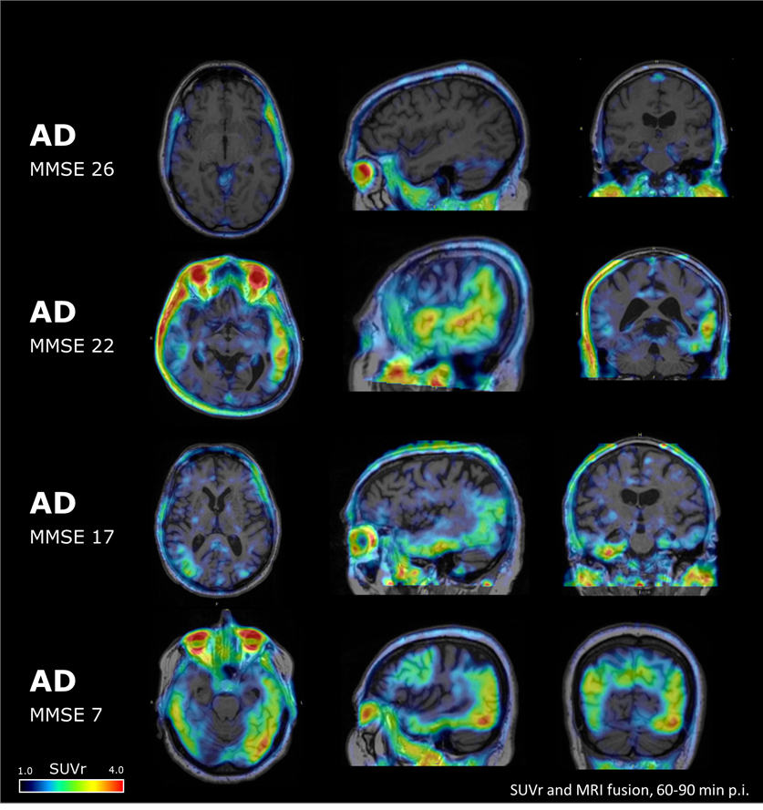
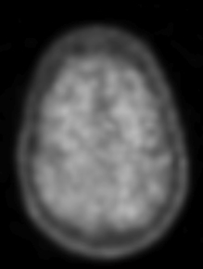
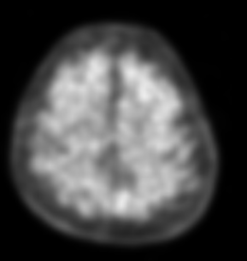
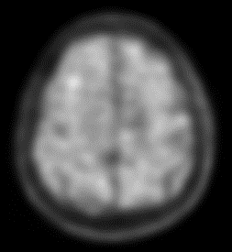
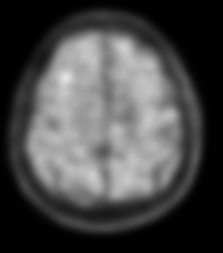
PI2620 tau distribution pattern observed in AD subjects
Florbetaben
cSUVr=1.40
cSUVr=1.62
cSUVr=1.53
cSUVr=1.62

